Slide 1
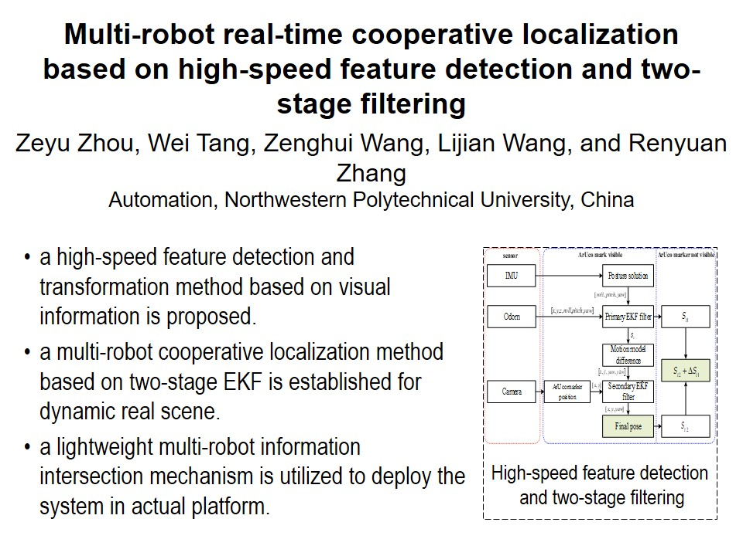
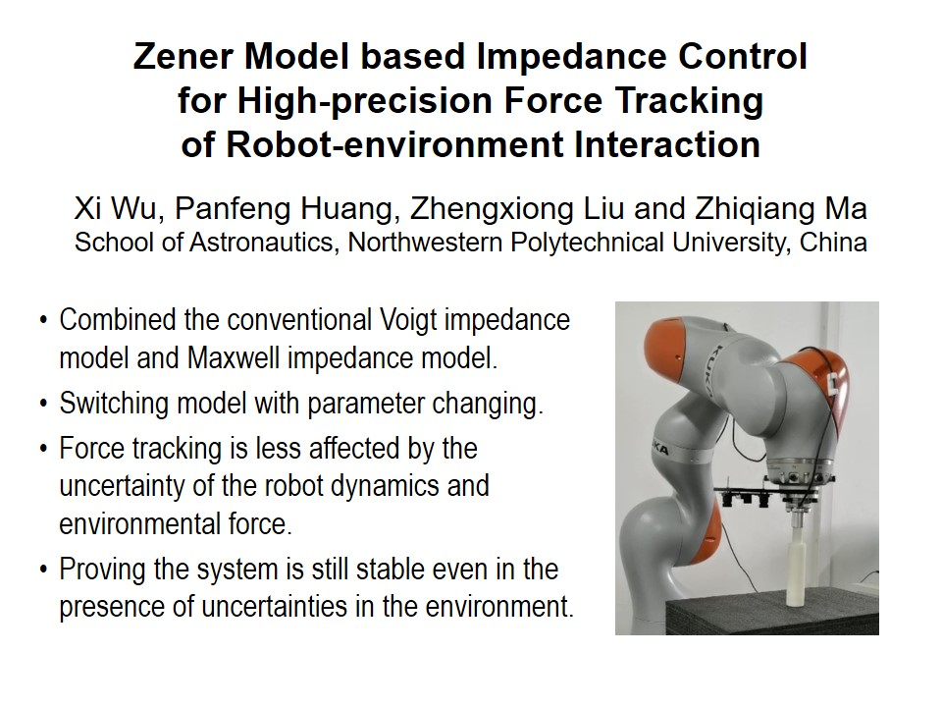
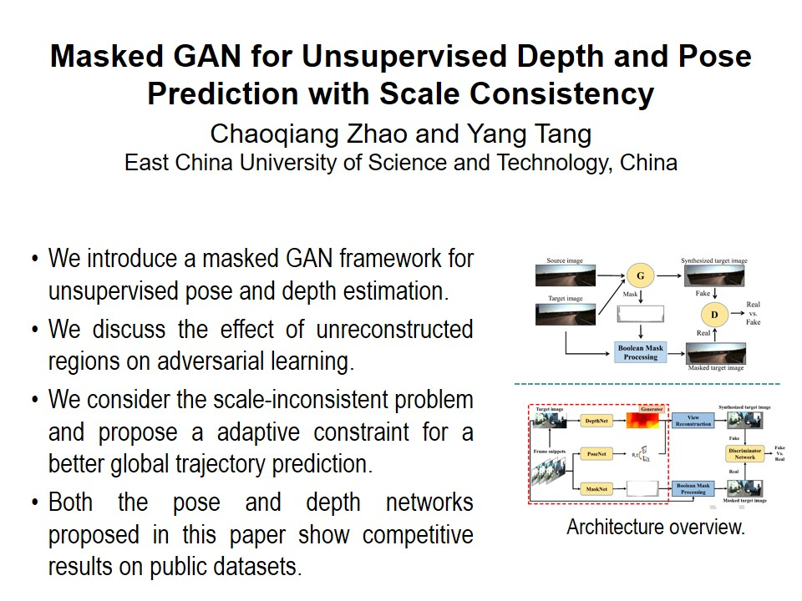
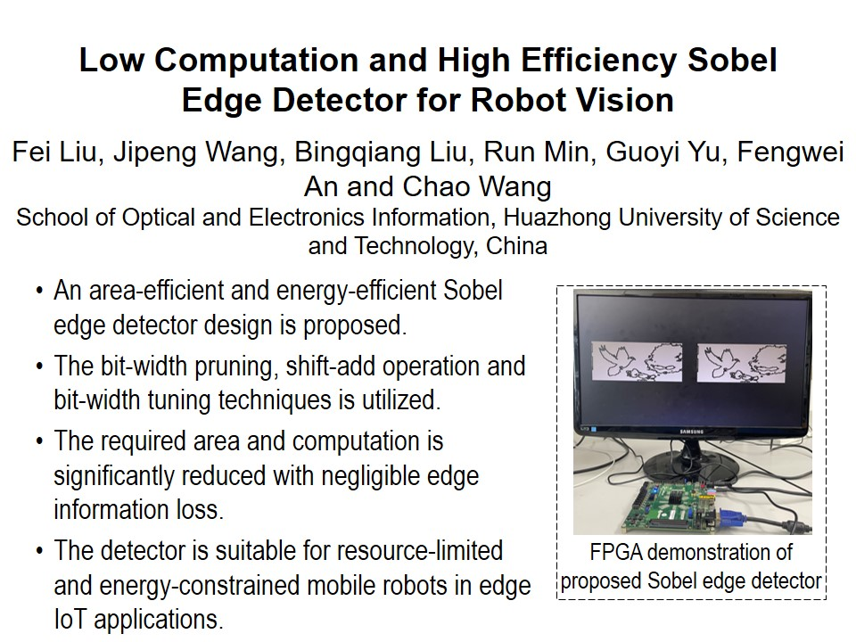

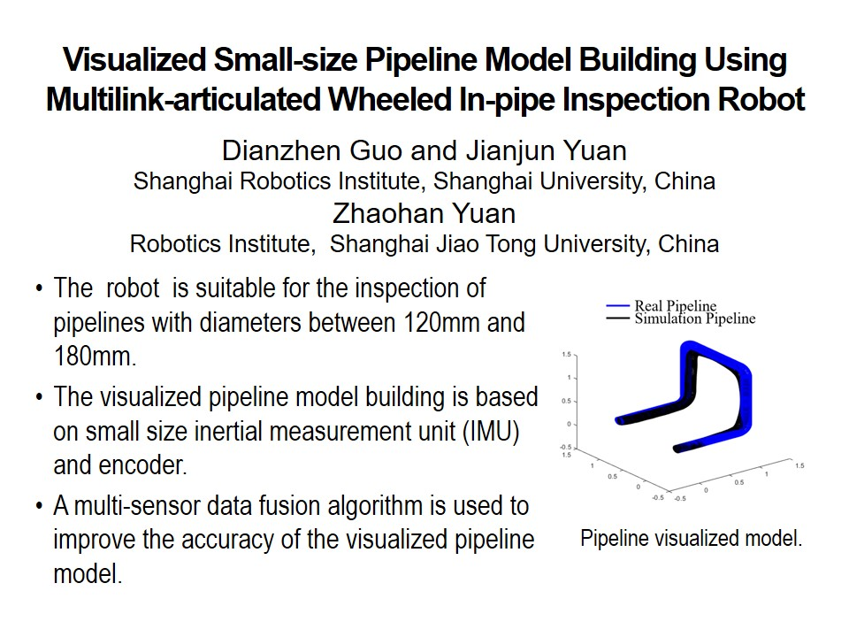
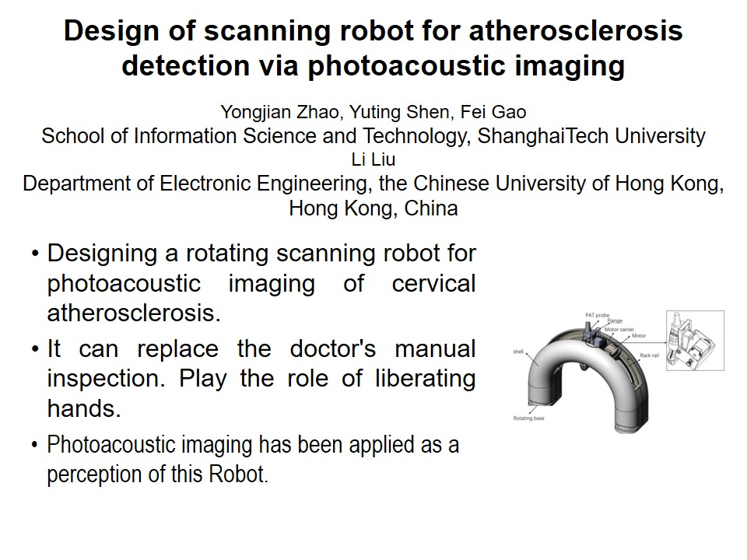

RCAR2021 Technical Sessions
FE6:Grasping stragety
Session Chair:Hong xinshi and Legend
Metting room1:July 15, 14:00-15:45, Friday
FE6-1, 14:00-15:45
FE6-1, 14:00-15:45
FE6-1, 14:00-15:45
FE6-1, 14:00-15:45
FE6-1, 14:00-15:45
FE6-1, 14:00-15:45
FE6-1, 14:00-15:45
FE6-1, 14:00-15:45

Slide 2
RCAR2021 Technical Sessions
FE6:Grasping stragety
Session Chair:Hong xinshi and Legend
Metting room1:July 15, 14:00-15:45, Friday
FE6-1, 14:00-15:45
FE6-1, 14:00-15:45
FE6-1, 14:00-15:45
FE6-1, 14:00-15:45
FE6-1, 14:00-15:45
FE6-1, 14:00-15:45

Slide 3


